Slide 1
Wire Sculpture
Using line to create form

Slide 2
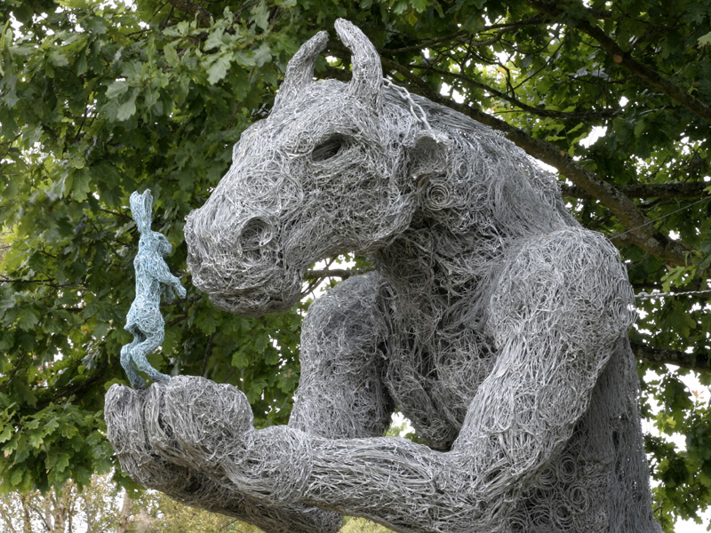
Wire Sculpture
Hare and the Minotaur Sophie Ryder, Wire and Bronze 2008

Slide 3
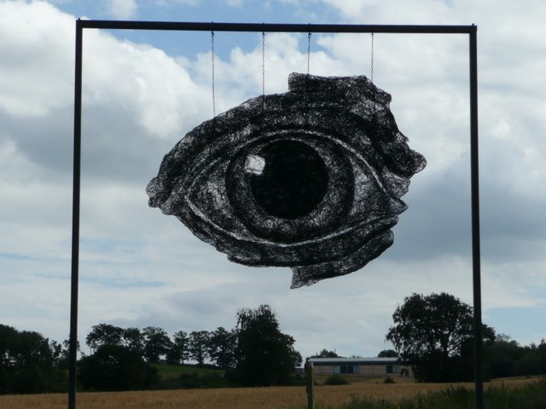
Sophie Ryder
Eye in the Sky Wire 2008

Slide 4
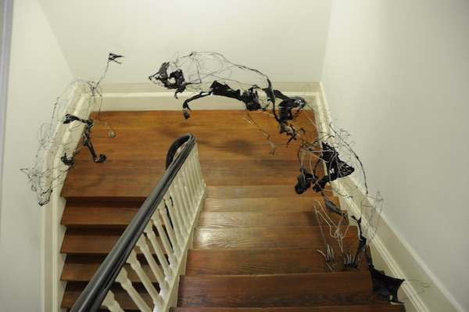
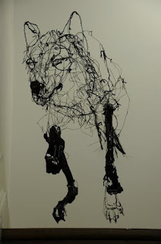
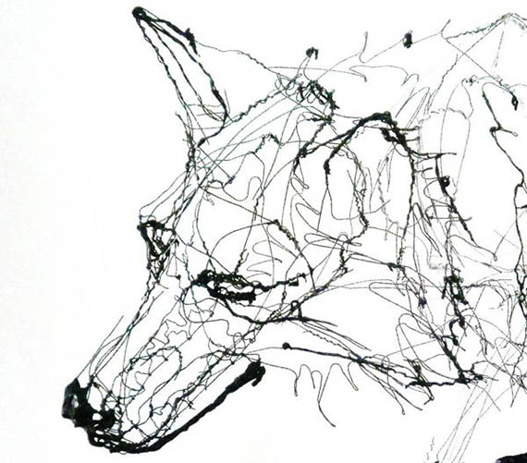
David Oliveira

Slide 5
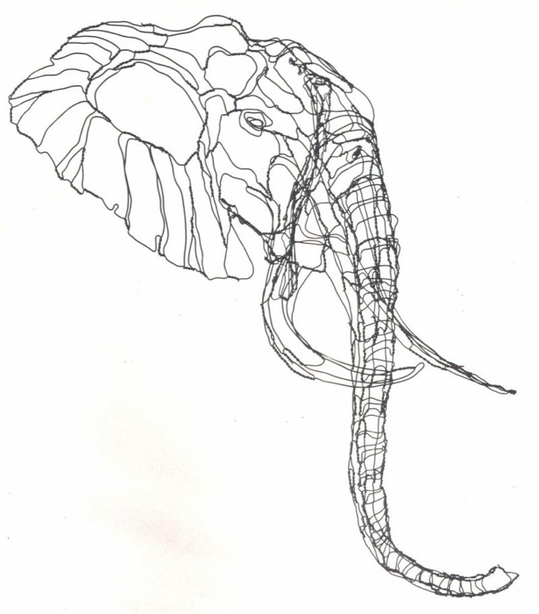
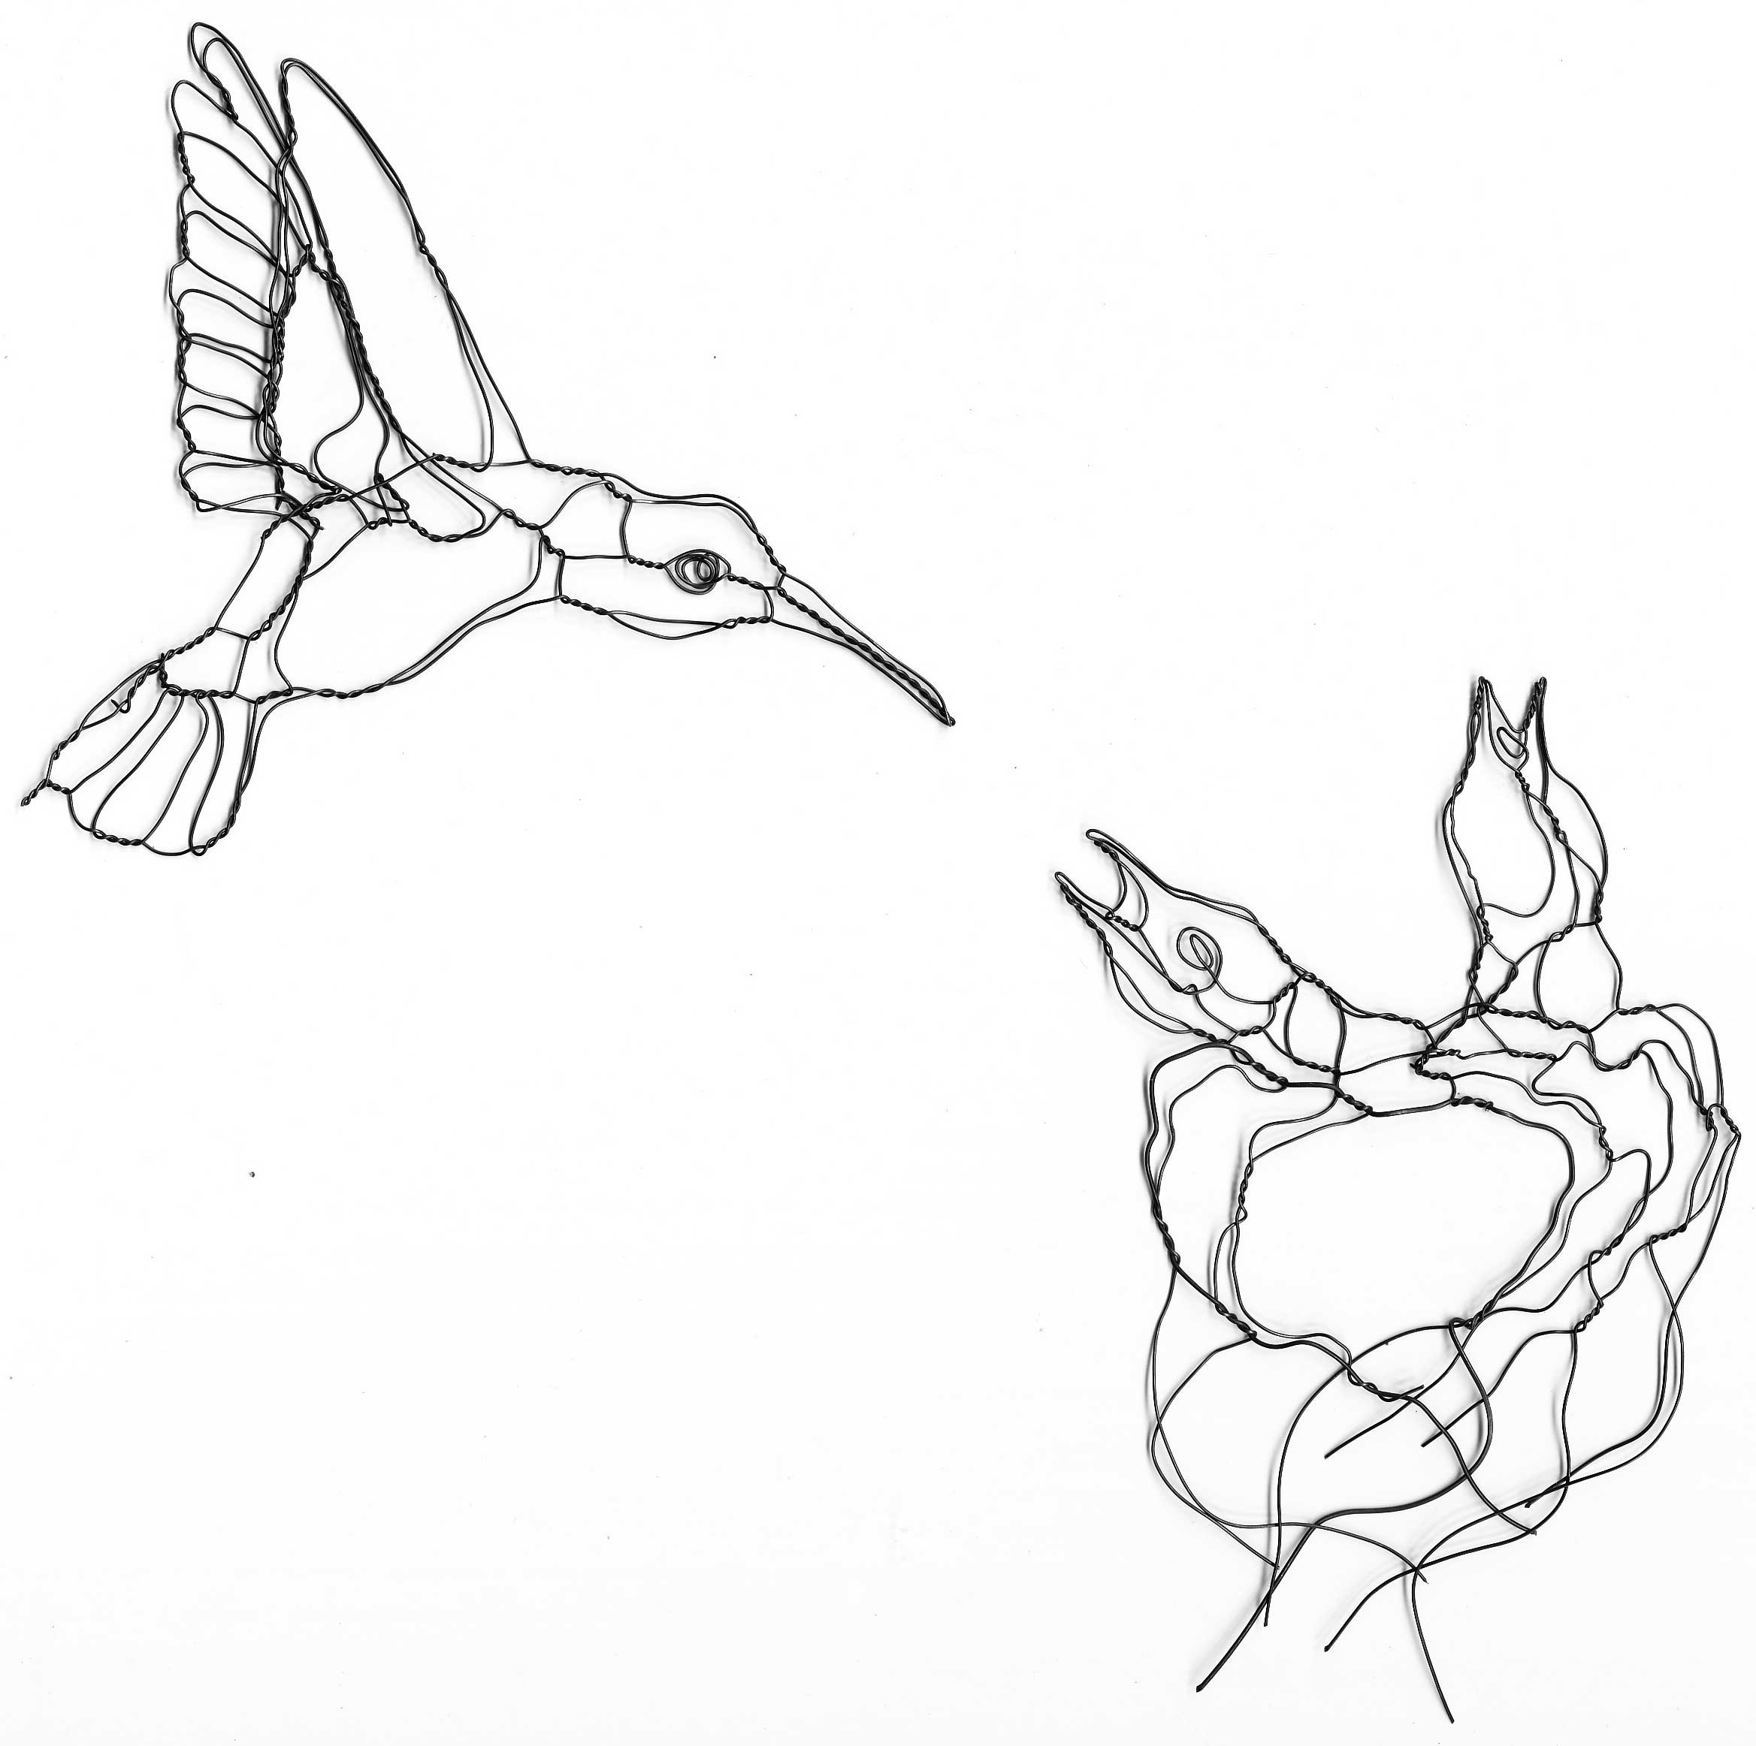
Elizabeth Berrien

Slide 6
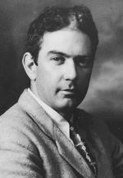
Alexander Calder
Alexander Calder was born in Lawnton, Pennsylvania on July 22, 1898 into a family of artists. The family moved to California when he was a boy. He began using scraps of wire he found in the street to make jewelry and beads for his sister’s dolls.

Slide 7
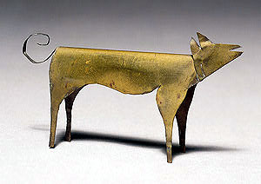
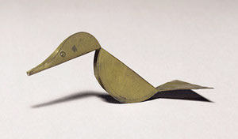
Dog (1909)
When he was in fourth grade, he sculpted a dog and a duck out of sheet brass as Christmas presents for his parents. The duck was “kinetic” because it rocked when touched. During his high school years, his family moved back and forth between New York and California. He studied mechanical engineering in college, graduating in 1919. For the next several years, he worked as an engineer, but finally he decided he would like to be an artist.
Duck (1909)

Slide 8
The Flying Trapeze (1925)
He moved to New York and enrolled in the art students’ League. One of his assignments was to sketch the Ringling Bros. Barnum & Bailey Circus. He became very interested in the circus, and would continue to create circus inspired art all through his career. In 1926, he moved to Paris and took up with a community of artists. He began to make toys, creating his “Cirque Calder”, a miniature circus made of wire, string, rubber & cloth. He made it small so he could fit it into a suitcase, allowing him to travel around giving “circus shows”.

Slide 9
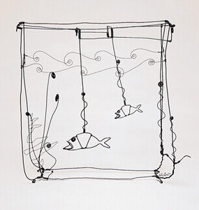
Cirque Calder sparked his interest in wire sculpture and kinetic art. (kinetic means pertaining to motion). He used his knowledge of engineering to create movable sculptures. Some of his circus characters could “perform” while suspended from a thread. His friend, artist Marcel Duchamp, dubbed these sculptures “mobiles” after the French word meaning mobile and motive. His early kinetic sculptures used cranks and pulleys to make them move. Later, his work was more delicate, and they only needed the current of the air to make them move.
Goldfish Bowl (1929)

Slide 10
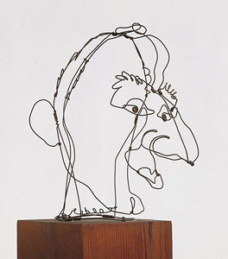
Jimmy Durante (1928)
Durante was a popular movie actor with a famously huge nose.
Circus Scene (1929)

Slide 11
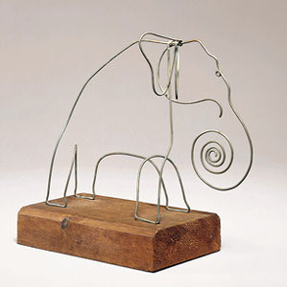
Alexander Calder
Elephant
Wire and Wood
1928

Slide 12
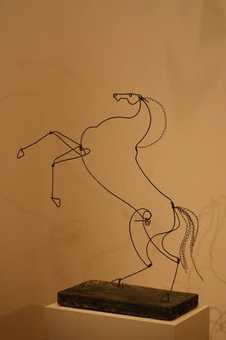
Rearing Stallion (c. 1928)
Alexander Calder

Slide 13
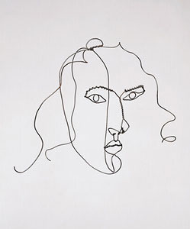
Alexander Calder
Medusa
Wire
c.1930

Slide 14
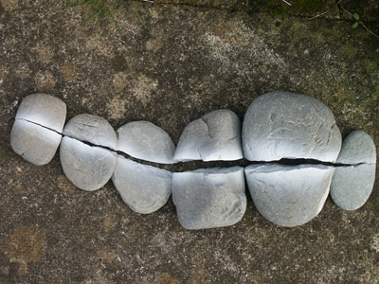
Line is an element of art which refers to the continuous mark made on some surface by a moving point. It may be one dimensional, like a pencil mark on a paper, or it may be three dimensional (wire) or implied (the edge of a shape or form.) Often it is an outline, contour or silhouette.

Slide 15
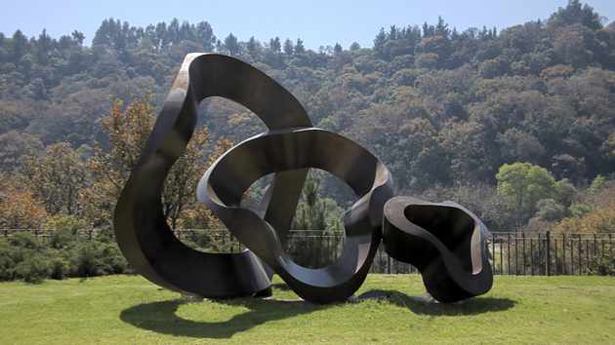
Form is an element of art that is three-dimensional and encloses volume. Cubes, spheres, and cylinders are examples of various forms.

Slide 16
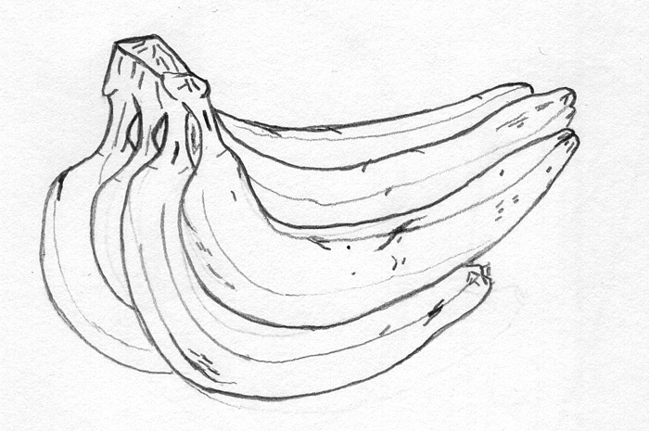
Contour Line Drawing
Contour means “outline”-simplicity of line design
Defines a form or edge-following the outermost visible exterior edge of a shape or form
Plain contour has a clean, connected line, no shading and emphasizes an open “shell” of the subject

Slide 17
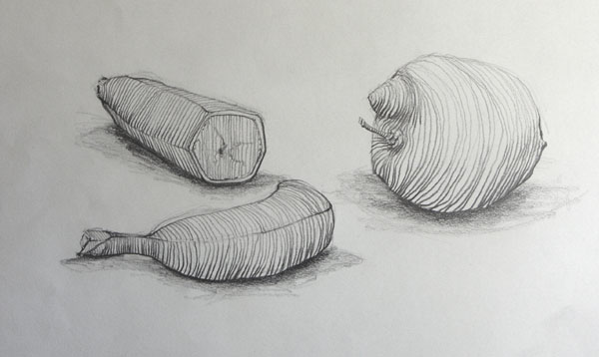
More complex contours can imply shading values through interior outlines and may have line textures
Pencil drawings, ball point pen and black markers are good practice tools
Characterized by perception and control and also demands practice to achieve competence

Slide 18
Drawing what you know…
Please spend about 3-5 minutes and create contour line drawings of one or two of the following items…
Apple
Pear
Pumpkin
Sunflower
Shell

Slide 19
Sculpting what you know…
Using a few pieces of wire, spend about 10-15 minutes and create a 3D wire sculpture of what you just drew.
Use short pieces of wire to start
Use wire cutters to cut pieces if needs be
Use your hands to manipulate the wire
If needed, use pliers to hold two pieces for joining
Take safety precautions
MIND YOUR EYES

Slide 20
Drawing what you see…
Now that you have these items in front of you.. Look again!!
Are there shapes, lines, contours that you forgot about?
Are there details you can add to enhance your drawing?
Let’s review and practice on a new sheet of paper…

Slide 21
Try again…
Focus on the lines that create the overall shape and form of the object - draw lightly with your pencil
Refine the lines to more specifically define the outline/shape-press a little bit more firmly with your pencil
Think about what the essential lines are in order to imply and show the objects essence

Slide 22
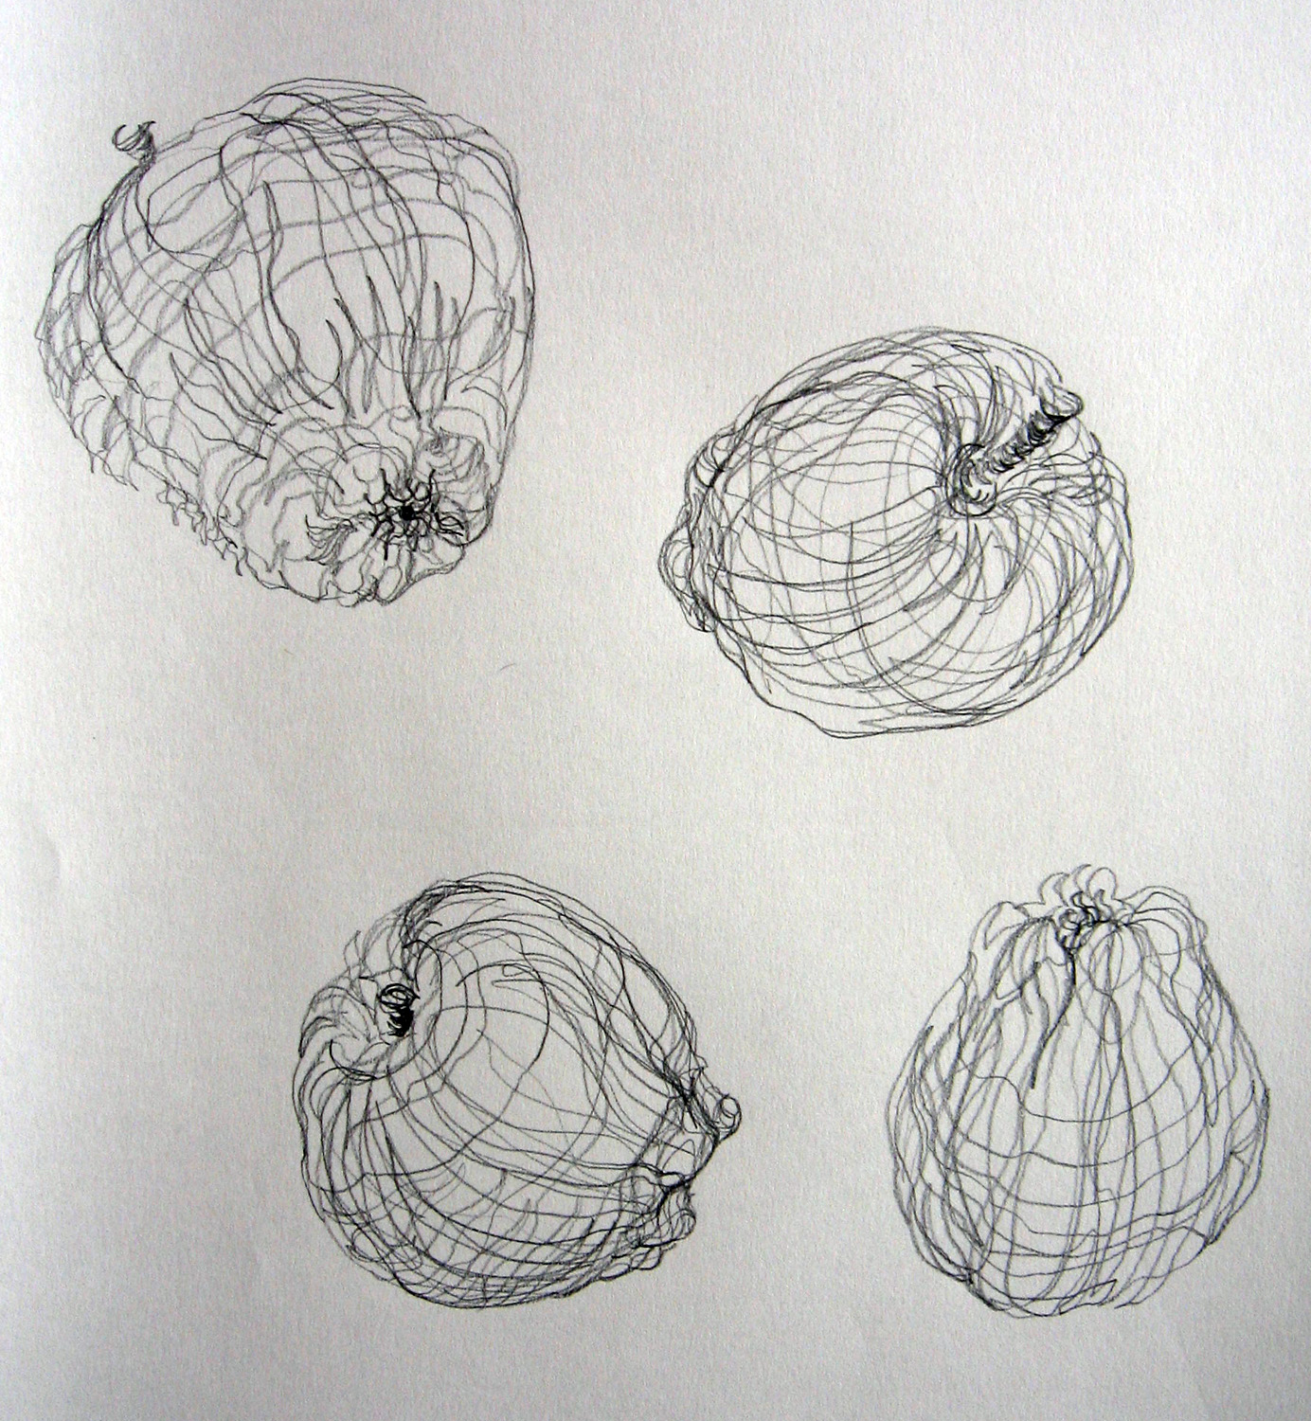
Use Cross Contour Lines
Once you have the outline, add a few additional lines to begin to give your drawing depth.

Slide 23
Try again…
When your drawing is complete trace over the final pencil lines with Sharpie marker
Save your drawing

Slide 24
Try again…
Create a new 3D version based on your new drawing.
Remember it can be viewed from all sides
Consider the form, volume and space of the object
Make sure it can stand or sit on the table

